Slide 1
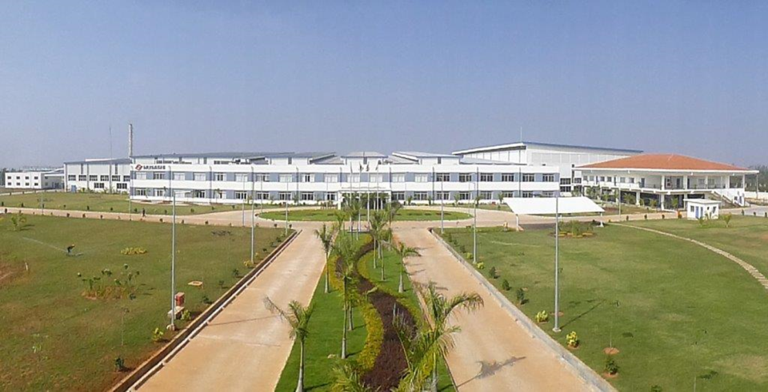



CIRCLE NAME: FLAME FIGHTERS
MUSASHI AUTO PARTS INDIA PVT LIMITED
BANGALORE PLANT
FLAME FIGHTING FORGERS

Slide 2
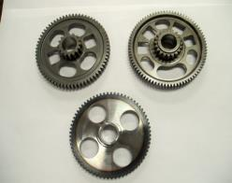
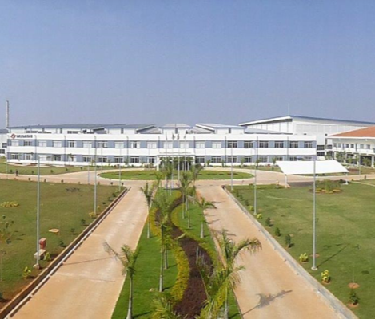
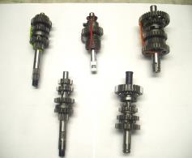
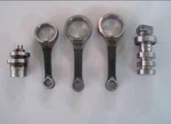
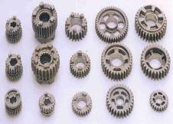
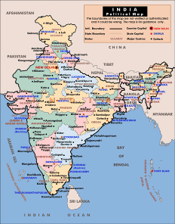
INTRODUCTION TO OUR COMPANY
QUALITY CIRCLE
MAP-ID IS SITUATED IN BENGALURU KARNATAKA.
WE PROCESS FORGINGS, PERFORM MACHINING, HEAT TREATMENT & ASSEMBLY OF CON RODS, CAM SHAFTS, GEARS & SHAFTS

Slide 3
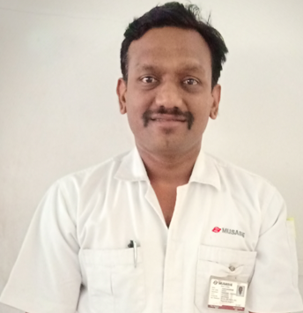






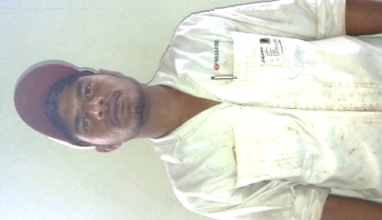


TEAM INRTODUCTION
ADVISOR
NAME : SAJIN SAN
TEAM LEADER
NAME : SIVAKUMAR SAN
DEPT : PROD- HF
FLAME FIGHTERS
TEAM MEMBER
NAME : MANJUNATH REDDY
DEPT : PROD- HF
TEAM MEMBER
NAME : ANJANEYA SAN
DEPT : PROD- HF
TEAM MEMBER
NAME : SARAVANAN SAN
DEPT : HOT FORGING
TEAM MEMBER
NAME : THIMMAPPA SAN
DEPT : HOT FORGING

Slide 4
FORGING DIE SETTING PART REJECTION REDUCTION
THEME AND TARGET
THEME
TARGET
FROM 0.45% TO 0.2%

Slide 5
PROBLEM SELECTION BY KJ METHOD
BY KJ METHOD “ FORGING OPERATION ” SELECTED

Slide 6
PROBLEM SELECTION BY KJ METHOD
BY KJ METHOD “LOAD SETTING REJECTION” PROBLEM POINTS SELECTED.

Slide 7
ACTIVITY PLAN
Sl No | Methodology Steps | Responsibility | P / A | FY 2018-19
 |  |  |  | DECEMBER 18 |  |  | JANUARY 19 |  |  | FEBRUARY 19 |  |  | MARCH 19
1 | FORMATION OF TEAM | SIVAKUMAR SAN | PLAN
 |  |  | ACTUAL
2 | CIRCLE MEETING (1/MONTH) | CIRCLE MEMBERS | PLAN
 |  |  | ACTUAL
2 | ANALYSIS OF THE PROBLEM | SIVAKUMAR SAN | PLAN
 |  |  | ACTUAL
3 | TARGET SETTING | SIVAKUMAR SAN | PLAN
 |  |  | ACTUAL
4 | PRESENT CONDITION ANALYSIS | MANJUNATH REDDY SAN | PLAN
 |  |  | ACTUAL
5 | IDEA GENERATION | CIRCLE MEMBERS | PLAN
 |  |  | ACTUAL
6 | FEASABILITY STUDY | MANJUNATH REDDY SAN | PLAN
 |  |  | ACTUAL
7 | TRAIL IMPLEMENTATION AND CHECKING PERFORMANCE | CIRCLE MEMBERS | PLAN
 |  |  | ACTUAL
8 | EFFECTIVENESS CHECK AND COUNTER MEASURE | SIVAKUMAR SAN | PLAN
 |  |  | ACTUAL
9 | FOLLOW UP / REVIEW & RECURRENCE PREVENTION AND DOCUMENTATION , SUSTAIN | SIVAKUMAR SAN | PLAN
 |  |  | ACTUAL

Slide 8
BACKGROUND ANALYSIS
JUNE -18 TO NOVEMBER-18 MONTH WISE REJECTION
JUNE -18 TO NOVEMBER-18 PART WISE REJECTION
K55 M4 CONTRIBUTED MORE REJECTION PERCENTAGE IN SETTING REJECTION

Slide 9
# KAIZEN POINT 1
UPSETTER PARTS REJECTION REDUCTION

Slide 10
CAUSE ANALYSIS
CAUSE ANALYSIS FOR MORE UPSETTER REJECTION DURING LOAD SETTING
METHOD
EVERY DIE DIFFERENT HEIGHT
MAN
BILLET NOT KEPT CENTER OF THE DIE
DIE FITTING
TOP UPSETTER DIE ADJUSTMENT NOT DONE
DIE WAVENESS
MASTER SAMPLE NOT AVAILABLE
DIES NOT FULLY TIGHTED
MORE UPSETTER REJECTION
LOAD
IMPROPER LUBRICATION
BILLET SCALES
DIES WORNOUT
IMPACT LOAD
WRONG LOAD INDICATION
DUST
BILLET WEIGHT OVER SIZE
RAM STROKE VARIATION
MACHINE
ENVIRONMENT
MATERIAL
BY THIS ANALYSIS FOUND MAJOR CAUSES IS UPSETTER MASTER SAMPLE NOT AVAILABLE SO 3 OR 4 UPSETTER PARTS GETTING REJECTED EVERY DIE SET UP

Slide 11
CURRENT CONDITION
UPSETTER DIAMETER MORE/LESS THAN REQUIRED DIAMETER (REJECTED)
AFTER UPSETTER TOP DIE ADJUSTMENT
(OK)
UPSETTER
TOP DIE
VVV
VVV
VVV
HOT BILLET
BOT DIE
STEP 1
STEP 1
STEP 1
STEP 4
K55 M4 PART REQUIRED UPSETTER DIAMETER IS 47 MM TO 47.5MM BUT ACTUAL PRODUCED DIAMETER MORE THAN OR LESS THAN REQUIRED DIAMETER SO THIS UPSETTER GETS REJECTED. AGAIN TOP DIE ADJUSTMENT REQUIRED UNTILL PRODUCE REQUIRED UPSETTER DIAMTER.

Slide 12
IMPROVEMENT IDEA
TOP UPSETTER ADJUSTMENT DONE BY USING MASTER SAMPLE
UPSETTER PART PRODUCED AS PER SAMPLE 47-47.5mm
MINIMIZED (3 - 4 NOS TO 1-2 NOS) UPSETTER REJECTION
TOP DIE
VVV
VVV
VVV
MASTER 47-47.5MM
HOT BILLET
BOT DIE
STEP 1
STEP 2
STEP 3
STEP 4
MADE UPSETTER MASTER SAMPLE ACCORDING REQUIRED DIAMETER
UPSETTER DIE ADJUSTMENT DONE BY USING MASTER SAMPLE
MINIMIZED UPSETTER REJECTION 3- 4 NOS IN TO 1 – 2 NOS.

Slide 13
# KAIZEN POINT 2
UNDERFILL PARTS REJECTION REDUCTION

Slide 14
CAUSE ANALYSIS
CAUSE ANALYSIS FOR MORE UNDERFILL REJECTION DURING LOAD SETTING
METHOD
EVERY DIE DIFFERENT HEIGHT
MAN
BILLET NOT KEPT CENTER OF THE DIE
THERE IS NO STANDARD FOR SLIDE ADJUSTMENT AFTER DIE CHANGE
SETTING
TOP UPSETTER DIE ADJUSTMENT NOT DONE
DIE WAVENESS
NO MASTER SAMPLE
DIES NOT FULLY TIGHTED
MORE UNDERFILL REJECTION
LOAD
IMPROPER LUBRICATION
BILLET SCALES
DIES WORNOUT
IMPACT LOAD
WRONG LOAD INDICATION
DUST
BILLET WEIGHT OVER SIZE
RAM STROKE VARIATION
MACHINE
ENVIRONMENT
MATERIAL
FOUND MAJOR CAUSES THAT IS THERE IS NO ANY STANDARD FOR SLIDE ADJUSTMENT AFTER FINISHER DIES CHANGES

Slide 15
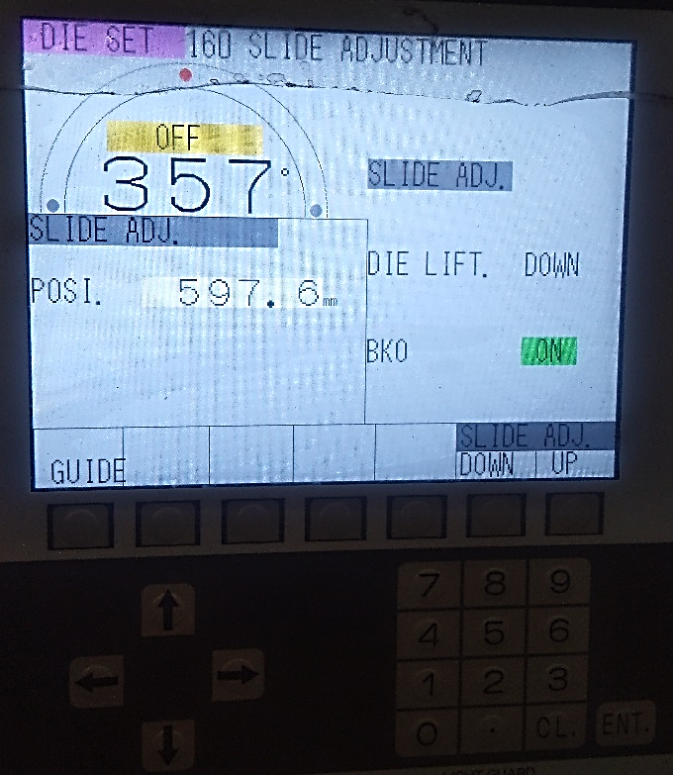
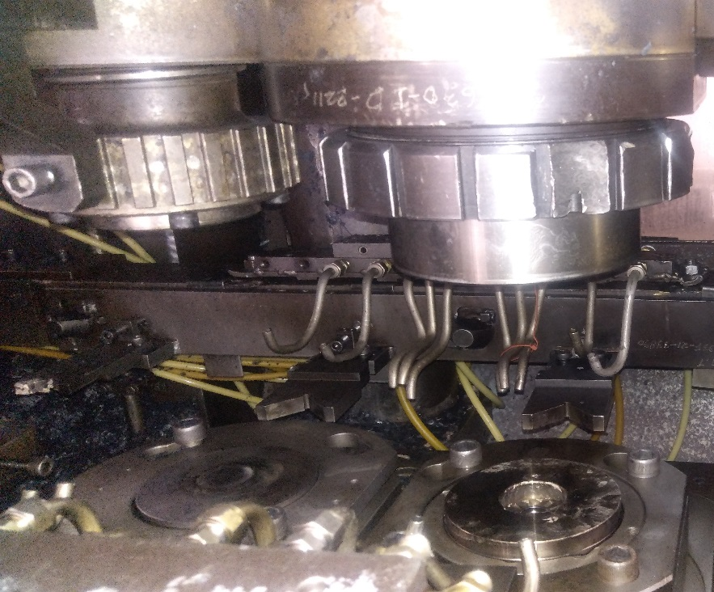
CURRENT CONDITION
UPSETTER OK
FIRST STAGE UPSETTER PART OK
BUT SECOND STAGE FINISHER PART FOUND UNDERFILL(REJECTED) DURING LOAD SETTING (NEW DIE SETTING)
BASED ON PREVIOUS PART UNDERFILL PERCENTAGE AGAIN ADJUSTING SLIDE HEIGHT THEN ONE MORE BILLET USING FOR LOAD SETTING MAY BE THIS PART ALSO GETS REJECTED REASON OF UNDERFILL.
LIKE THIS 3-4 PARTS GETTING REJECTED IN THE REASON OF UNDERFILL
REASON NO STANDARDS AVAILABALE FOR SLIDE HEIGHT ADJUSTMENT AFTER DIE CHANGE

Slide 16
DIFFERENCE VALUE 428.94 FOUND CONSTAND GAP FOR SLIDE HEIGHT AND TOTAL DIE HEIGHT
IMPROVEMENT IDEA
 |  | VARIABLES |  |  | CONSTANT |  |  |  |  | KAIZEN IDEA |  | RESULT
 | PART NAME | TOP DIE HEIGHT | BOTTOM DIE HEIGHT | SLIDE HEIGHT | UPSETTER DIAMETER | UPSETTER THICKNESS | REQ LOAD (220-240T) | KO PIN LEVEL | CASE | (TOTAL HEIGHT) TOP+BOT | DIFFERENCE (TOTAL DIE HEIGHT-SLIDE HEIGHT) | PARTS REJECTED DUE TO UNDERFILL
1ST TIME DIE CHANGE | K55 M4 | 63.2 | 107.06 | 599.2 | 47.1/47.5 | 15.5/15.9 | 230 | 0.5 | 13 | 170.26 | 428.94 | 5
 |  | VARIABLES |  |  | CONSTANT |  |  |  |  | KAIZEN IDEA |  | RESULT
 | PART NAME | TOP DIE HEIGHT | BOTTOM DIE HEIGHT | SLIDE HEIGHT | UPSETTER DIAMETER | UPSETTER THICKNESS | REQ LOAD (220-240T) | KO PIN LEVEL | CASE | (TOTAL HEIGHT) TOP+BOT | DIFFERENCE (TOTAL DIE HEIGHT-SLIDE HEIGHT) | PARTS REJECTED DUE TO UNDERFILL
1ST TIME DIE CHANGE | K55 M4 | 63.2 | 107.06 | 599.2 | 47.2/47.7 | 15.5/15.9 | 230 | 0.5 | 13 | 170.26 | 428.94 | 5
2ND TIME DIE CHANGE | K55 M4 | 62.7 | 106.8 | ? | 47.1/47.5 | 15.5/15.8 | 230 | 0.5 | 13 | 169.5 |  | 2
SLIDE HEIGHT SETTED WITHOUT ANY PART REJECTED
428.94 + 169.5 = 598.44
BEFORE MAKING TRIAL PART DIRECTLY SLIDE ADJUSTMENT DONE BY USING ABOVE CALCULATION, SO DIE LOAD SETTING REJECTION MINIMIZED 4 TO 2 NOS

Slide 17
RESULT
DESCRIPTIONS | BEFORE | AFTER
REJECTED QTY FOR 1 DIE SETTING | 5 NOS | 3 NOS
EACH SHIFT AVERAGE DIE CHAGING FREQUENCY | 3 TIMES | 3 TIMES
EACH SHIFT TOTAL REJECTION | 15 NOS | 9 NOS
PER PRESS | 15*3=45 NOS | 6*3=27 NOS
HF1 & HF2 PRESS | 45+45=90 NOS | 27+27=52 NOS
42 NOS SAVED PER DAY

Slide 18
THANK YOU

